Slide 1

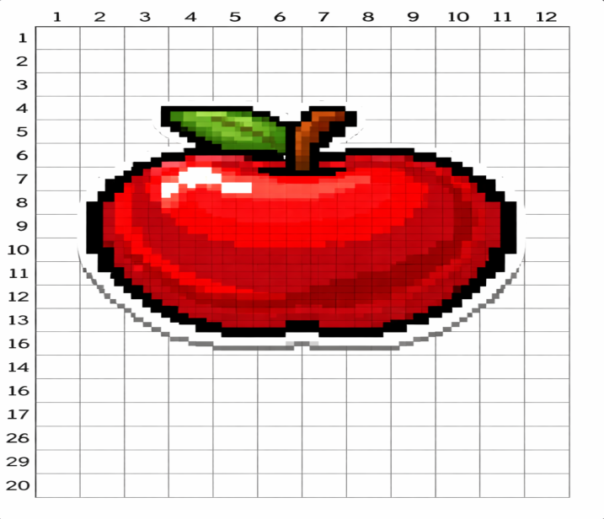
Eg:

Slide 2
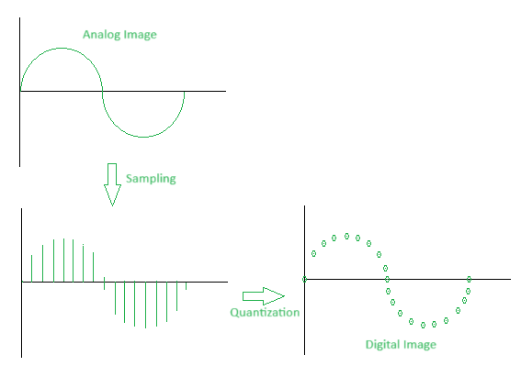

Slide 3
Sampling and Quantisation
What is Image Sampling?
  Image sampling is the process of converting a continuous image (analog) into a discrete image (digital) by selecting specific points from the continuous image. This involves measuring the image at regular intervals and recording the intensity (brightness) values at those points.
How Image Sampling Works?
  Grid Overlay: A grid is placed over the continuous image, dividing it into small, regular sections.
  Pixel Selection: At each intersection of the grid lines, a sample point (pixel) is chosen.

Slide 4
Image Sampling:
  Advantages:
  Data Reduction: Converts a continuous signal into a finite set of points, making storage and processing more manageable.
  Compatibility: Sampled images are easily processed by digital systems and algorithms.
  Resolution Control: Allows for control over image resolution by adjusting the sampling rate.

Slide 5
  Image Sampling
  Disadvantages:
  Information Loss: Inevitably loses some information by approximating a continuous signal.
  Aliasing: Can cause distortions and artifacts if the sampling rate is too low.
  Computationally Intensive: High-resolution sampling demands significant computational resources and storage space.

Slide 6
Sampling and Quantization
What is Image Quantization?
  Image quantization is the process of converting the continuous range of pixel values (intensities) into a limited set of discrete values. This step follows sampling and reduces the precision of the sampled values to a manageable level for digital representation.

Slide 7
How Image Quantization Works?
  Value Range Definition: The continuous range of pixel values is divided into a finite number of intervals or levels.
  Mapping Intensities: Each sampled pixel intensity is mapped to the nearest interval value.
  Assigning Discrete Values: The original continuous intensity values are replaced by the discrete values corresponding to the intervals.

Slide 8
Image Quantization:
  Advantages:
  Data Compression: Reduces the amount of data by limiting the number of possible values for each pixel.
  Simplified Processing: Makes image processing operations simpler and faster with fewer distinct values.
  Noise Reduction: Helps reduce the impact of noise by mapping small variations in intensity to the same value.

Slide 9
Image Quantization:
  Disadvantages:
  Loss of Detail: Reduces the range of colors or intensity levels, leading to a loss of fine detail and potential color banding.
  Quantization Error: Introduces differences between the original and quantized values, which can become noticeable.
  Reduced Image Quality: Overly aggressive quantization can significantly degrade image quality, making the image appear blocky or posterized

Slide 10
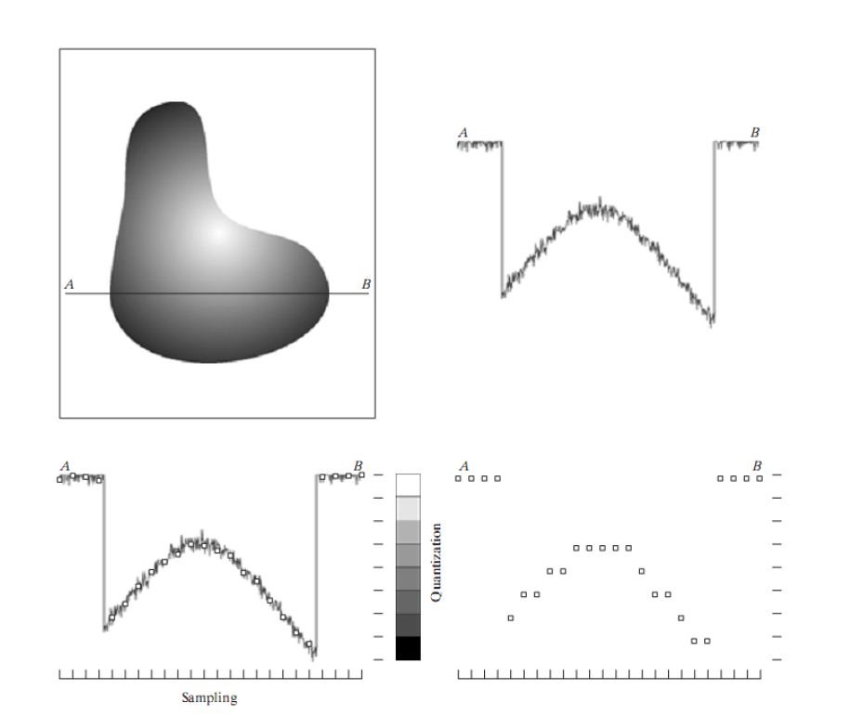

Slide 11
